Slide 1


tmux: Tools to enhance your terminal
RC Account
Registration

Slide 2

View the Slides
https://github.com/ResearchComputing/rmacc_2025

Slide 3
Session Outline
Overview of tmux
Basics of tmux Usage
Tools to simplify tmux
Best practices on CU Research Computing

Slide 4


You can always ask questions!
Ask Questions
Discuss Ideas

Slide 5
Overview

Slide 6
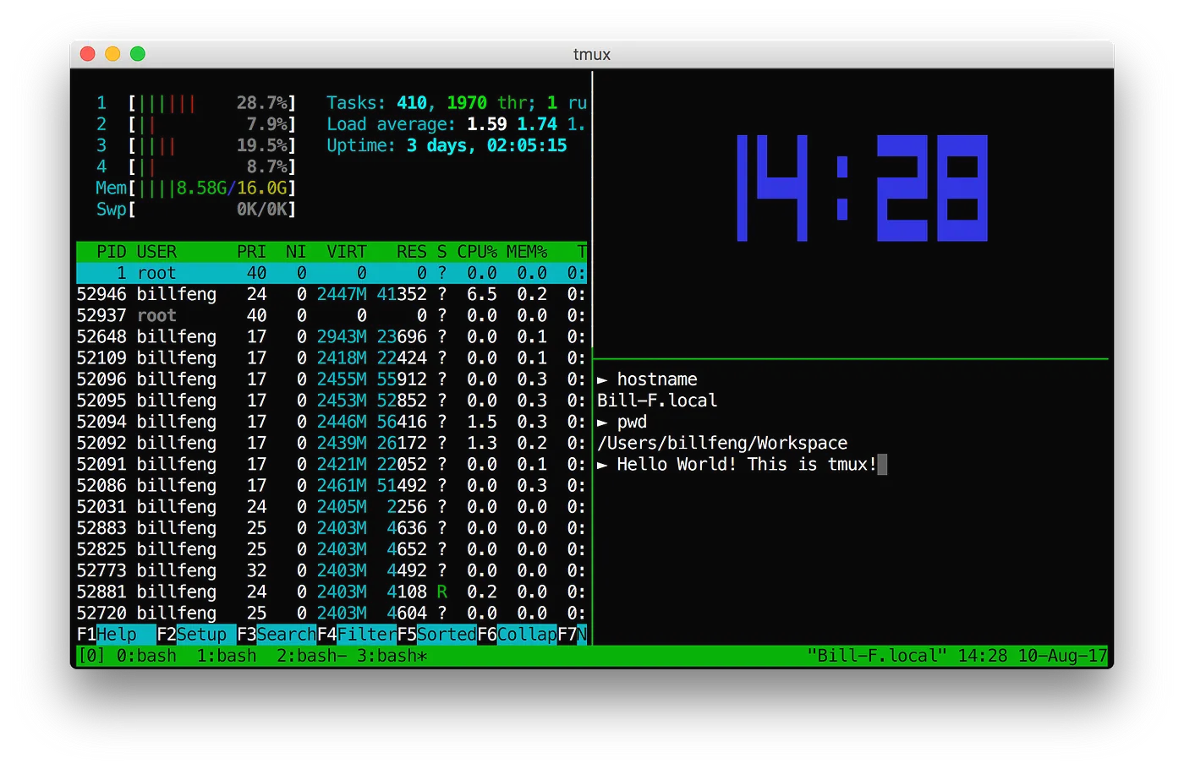
What is tmux?
tmux = terminal multiplexor
Allows you to split your terminal into multiple “panes”, as well as keep terminal sessions alive

Slide 7
Basics of tmux Usage

Slide 8
Logging into CU Research Computing
login to CURC via your terminal (CU Boulder or CSU users):
$ ssh monaghaa@login.rc.colorado.edu
…or login to CURC via your browser (all users):
https://ondemand-rmacc.rc.colorado.edu
(once logged in, navigate to Clusters -> Alpine shell)
Notes:
sinteractive --partition=atesting --qos=testing --time=90:00 --ntasks=1

Slide 9
Getting Started
Once logged in, attach to a tmux session:
$ tmux (#first time you start session)
$ tmux attach (# when reconnecting to session)

Slide 10

Prefix and Command Keys
tmux uses a set of prefix and command keys to:
Attach and detach sessions
Split the terminal into panes
Move between terminal panes
Create and switch between new windows
Close panes and windows
tmux always uses Ctrl-B (denoted as C-b) for its prefix, followed by another character for the command
Even on Macs!
Press the prefix keys at the same time, then let go, and press the command key!

Slide 11
Basic Commands
Split terminal left/right: C-b %
Split terminal top/bottom: C-b “
Move to a different pane: C-b <arrow key pointing to pane>
Close a pane: Ctrl-d or type exit
Create new window: C-b c
Switch between windows: C-b n (next) or C-b p (previous)
Detach from session: C-b d
List sessions: tmux ls
Attach to specific session: tmux attach n, where n is the session number

Slide 12
Demo

Slide 13
Tools to simplify tmux

Slide 14
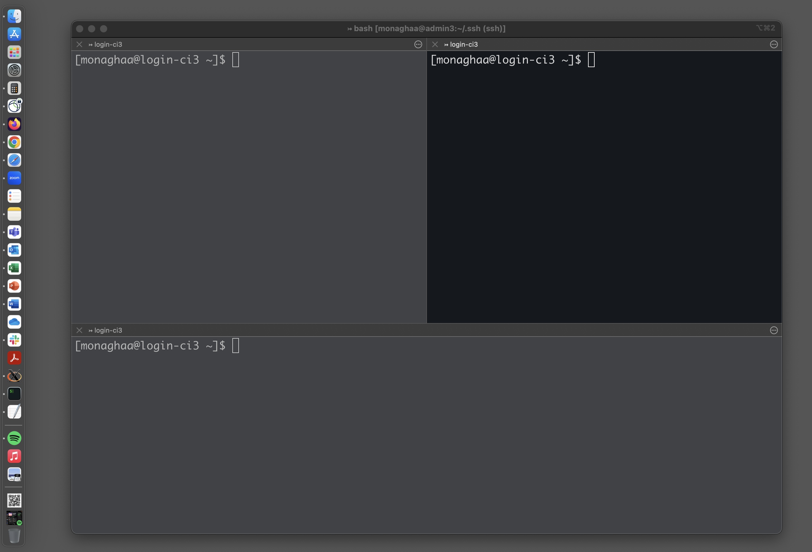
Integration of tmux for Mac: iTerm2

Slide 15
Using iTerm2
From your laptop, ssh to a specific CURC login node (login-ci[3,4,5]):
$ ssh ralphie@xsede.org@login-ci4.rc.colorado.edu
Once logged in, attach to a tmux session with the `-CC` option
$ tmux -CC (#first time you start session)
$ tmux -CC attach (# when reconnecting to session)
Now use tmux in the iTerm2 terminal with all tmux syntax abstracted!
Demo….

Slide 16
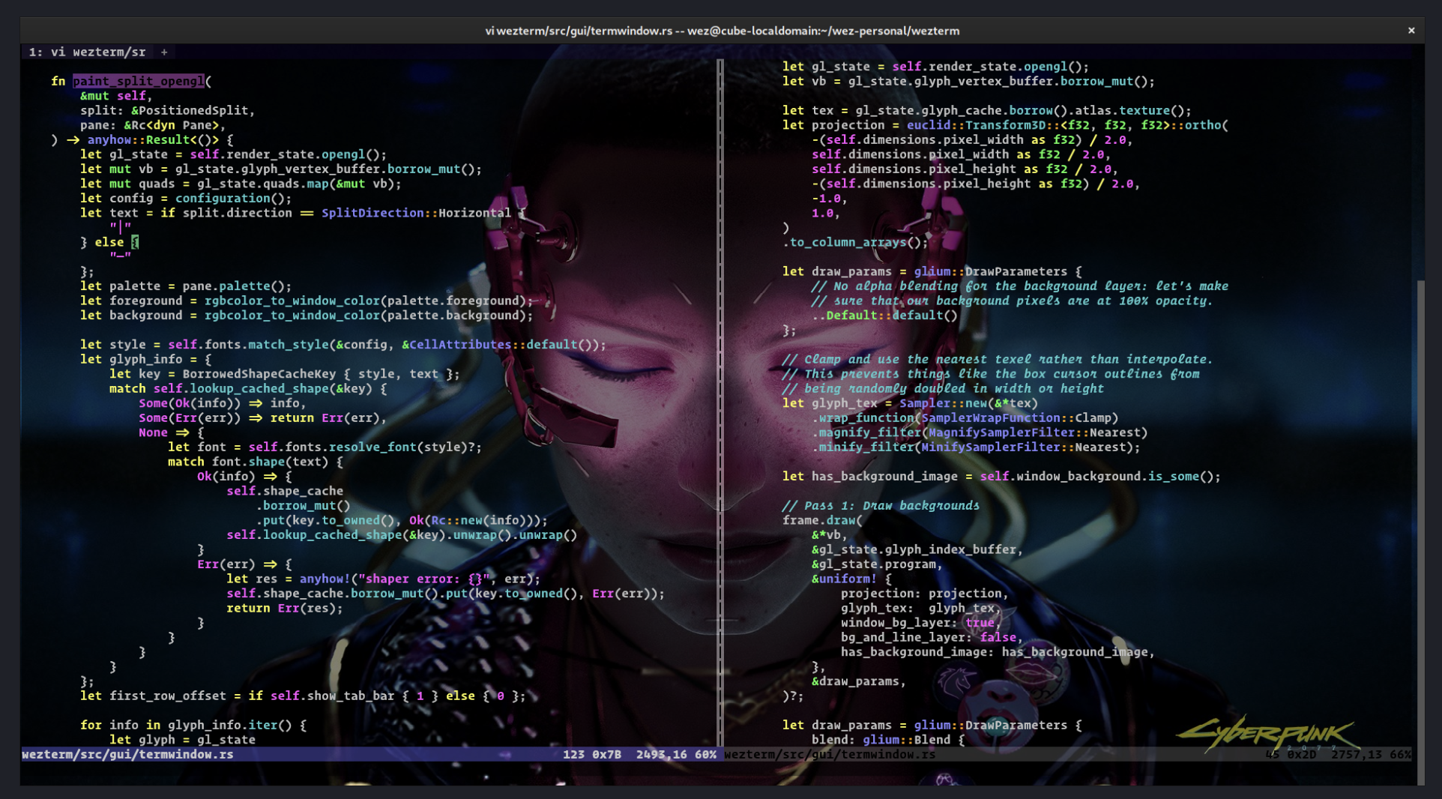
Similar tmux integration options for Windows:
Terminal emulators that support tmux’s control (`-CC`) mode, which enables abstraction of tmux syntax:
Native option: Windows Terminal w/ WSL
additional docs on –CC option
iTerm-like option: Wezterm →

Slide 17
Best Practices

Slide 18
Best Practices for using tmux on CURC
Run on specific login nodes
Reason: these are rarely rebooted so sessions will persist for weeks or months
Do not run on compute nodes
Reason: sessions will end when job ends
Keep it simple – i.e., no plugins or special features
Reason: plugins often consume more resources than are available on login nodes
When in doubt, ask rc-help@colorado.edu

